Slide 1
Recording Marcos for VBA
Week 5, Days 17-18

Slide 2
Reminder: make sure “Macros” are enabled
MS Office locks out custom programming by default – without warning you about it!
Go to File → Options → Trust Center → Trust Center Settings → Macro Settings
Check either “Disable all macros with notification” (will ask you whether to allow them each time you open a file with macros) or check “Enable all macros”
You need to enable macros BEFORE opening your workbook – the change does not affect files already open

Slide 3
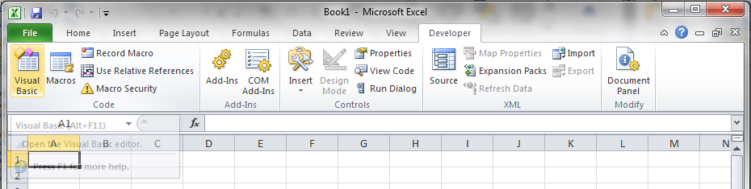
Reminder: Make“Developer” tab visible & go to VB Editor
If the Developer tab is not visible,
Go to File → Options → Customize Ribbon
On the right-hand pane, check “Developer” under “Main Tabs” & click “OK”
Go to Developer → Visual Basic (or press Alt + F11)

Slide 4
Reminder: All code goes in a “Module”
In VBA, Insert a new Module
Do NOT insert a “Class Module”
All VBA code is written in modules
All of your code for in-class exercises or homework should be in a single module!
A workbook can contain multiple modules, just as it can contain multiple worksheets
All worksheets in a workbook have access to functions written in any or all of the modules in that same workbook only

Slide 5
Reminder: Sub Procedure Syntax
VBA Sub Procedure Syntax
Sub MySubName() Note: nothing in the parenthesis!
<Inputs>
<Calculations>
<Outputs>
End Sub
Sub procedure name has same rules as variable names
NO arguments in a Sub procedure — for our purposes, parenthesis are just place-holders (like PI function in Excel)
No built-in provision for input & output!

Slide 6
“Object-Oriented” Programming
Visual Basic is “object oriented”
Items are referred to in a cascade from general to specific, separated by periods
An analogy would be the description of a specific command/button in the tool ribbon
The most general object in VBA for Excel is the Excel “Application”
This is implicitly assumed and we don’t need to worry about it
Other objects:
Workbook, Worksheet, Cells, etc.

Slide 7
Object-Oriented Shortcuts
Don’t need to refer to the whole structure from the Excel application on down
Example: Range(“A1”).Font.Name=“Arial” (Application.Workbook(“Book1”).Worksheet(“Sheet1”) .Range… is assumed if Sheet1 in Book1 is “active”.)
Referring to the currently selected cell on the currently selected worksheet
Example: If cell B7 is currently selected, Range(“B7”) and ActiveCell mean the same thing, (the Application.Workbook(“Book1”).Worksheet(“Sheet1”)... part is assumed again)

Slide 8
Review: Week 4 In-class Exercise #6 (cont.)
Write a program to take diameter, d, from Excel spreadsheet cell B8 and get user input for the value of height, h, (then write the value in Excel cell B9). Write and call Functions in the Sub to calculate the volume, lateral surface area, base surface area & total surface area of a right circular cone. Display the results in both a message box and also in cells B11 & B12.
Cone Volume: V = ¹/₃ π r² h
Cone Surface Area: A_{L} = π r (r² + h²)^{½} A_{B} = π r²

Slide 9
Review: Week 4 In-class Exercise #6 (cont.)
What about pi?!
Excel has a function: =PI(), but VBA does not
Three choices:
Manually assign value of pi pi = 3.14159265 or pi = 22/7 (approx. for pi, good to 3 decimal places)
Use arctan (inverse tan) function available in VBA: pi = 4 * Atn(1)
Try to get to Excel’s pi() function
We can use a limited number of Excel’s worksheet functions in VBA, PI() is one of them: pi = WorksheetFunction.Pi()
We can use “pi” as the variable name, because it’s not a “reserved word” in VBA

Slide 10
Debugging
Debugging – Checking for syntax errors, execution errors, logic errors etc.
In VBA, click on Debug tab, then Step into
Hit ‘F8’ to move the cursor down and keep checking each line. It takes you through the lines in the order in which the program is executed.
Move your cursor to a variable and it will show the value assigned if any
In the VB Editor, go to the “View” menu and select “Locals Window”
The name, type, and value of all variables will be shown
Hit ‘F9’ or click on the grey bar to the right of the code to set a break. A subroutine will halt whenever it encounters a break

Slide 11
Recording Macros
You can automate a sequence of Excel commands which you may reuse by using a macro
You can use a recorded macro to learn how to write VBA codes

Slide 12
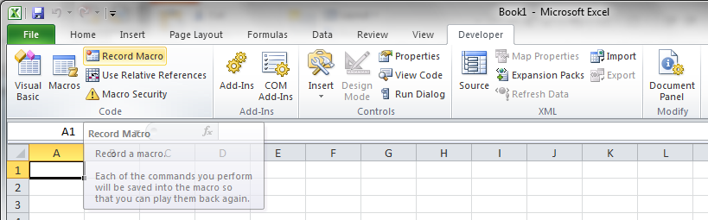
Recording a Macro: Example
Enter some name in a cell.
Click on the cell
Click on record macro in the developer tab

Slide 13
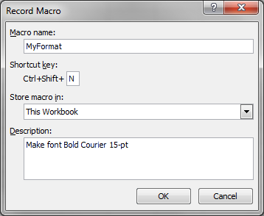

Recording a Macro: Example
In the record dialogue box, Enter the name as, say, Format. Also enter a shortcut key. Lets say, ‘N’ (capitals). Then hit OK
Now perform all the tasks you would like to be recorded. Carefully do it step by step in an order. Right click on the cell and click on format and change to bold Courier New 15-point
Stop recording

Slide 14
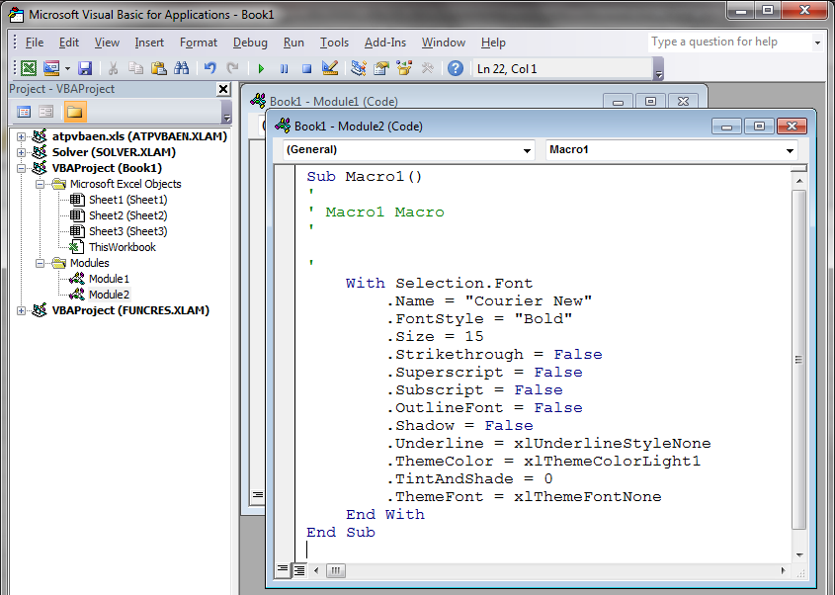
Recording a Macro: Example
Go to VBA and check. Record Macro creates a new module with the code generated by the recording.
In Excel, check if the macro works fine by testing it on a different cell using the shortcut key you created. (Ctrl+Shift+N)

Slide 15
Object-Oriented Structure (cont.)
Notice the “With” syntax!
With is another shorthand notation when you are performing a lot of operations on the same object – in this case a cell
Instead of : ActiveCell.Font.Name = “Courier New” ActiveCell.Font.Bold = True ActiveCell.Font.Size = 15
We can write: With Selection.Font .Name = “Courier New” .Bold = True .Size = 15 End With
The recorded macro includes all of the values the Font dialog box can change — we can include just the values we actually change

Slide 16
In-class exercise #1
A) Record a macro to format a Cell to be Arial, bold, font size 15 pt. and italics.
B) Record a macro to format a number to be expressed in scientific notation with 3 decimal places.
C) Write a program to count the number of rows and columns in the matrix starting in cell A5. Record a macro to help you.

